Slide 1

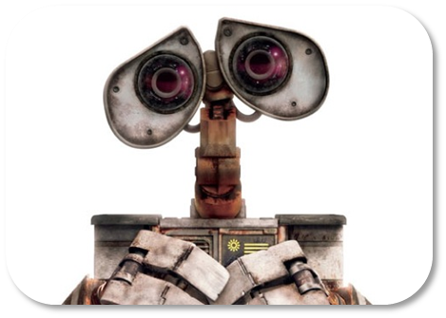
Welcome to
Robot Programming

Slide 2
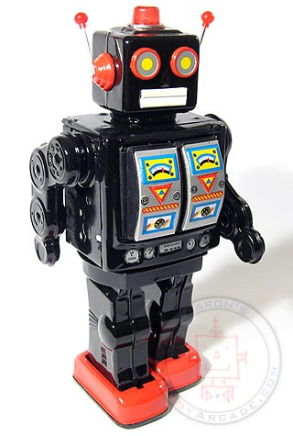
Them’s the Rules:
“Robots only do what you tell them to”
robot – machine which performs difficult tasks on command
program – set of instructions
programmer – person who writes the robot’s instructions

Slide 3
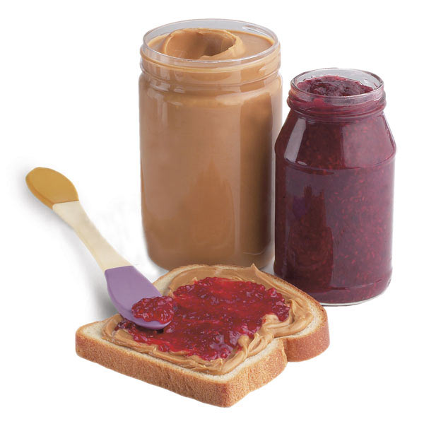
PB J Robot
Robot Instructions | Human Instructions

